Slide 1
DBS HACKTHON PHASE-II
Virtual Room : 69
CUSTOMER RATING SYSTEM
Name of the Team : HACK SQUAD

Slide 2
Introduction
Every bank runs on trust of it’s customer and it is equally important for a bank to maintain reputation in the market.
One scam or money laundering activity could make a bank reputation to go on toss. To avoid this, we introduce “Customer Rating System”.

Slide 3
Technologies
HTML
CSS
Javascript
Bootstrap
MYSQL
Django

Slide 4
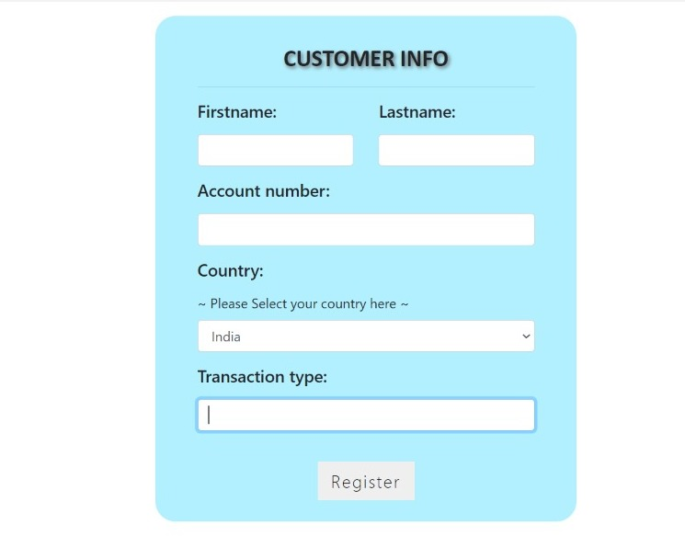
Login Page

Slide 5
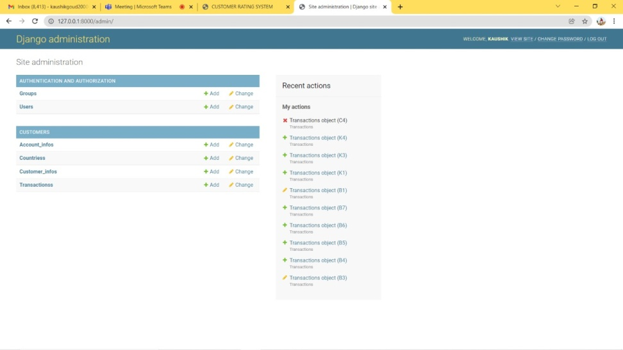
Administration

Slide 6
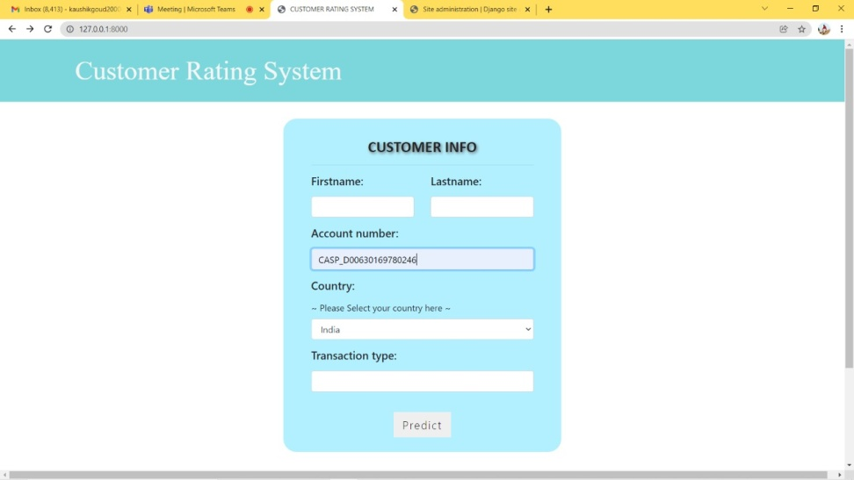
Credentials

Slide 7
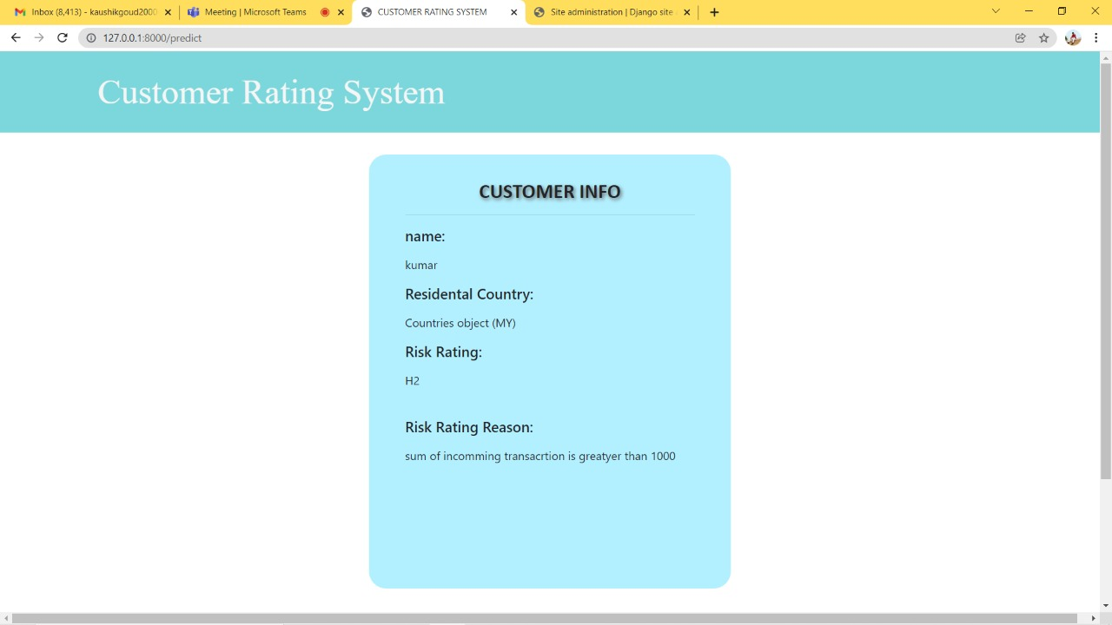
OUTPUT

Slide 8
Thank You……. Visit our project through : https://github.com/AkankshaAgarwal7/VirtualRoom69-HackSquad

